Slide 1
MATH-352 Numerical Methods
Atifa Kanwal
atifa.kanwal@seecs.edu.pk
Office # 303, Faculty Block, SEECS, NUST

Slide 2
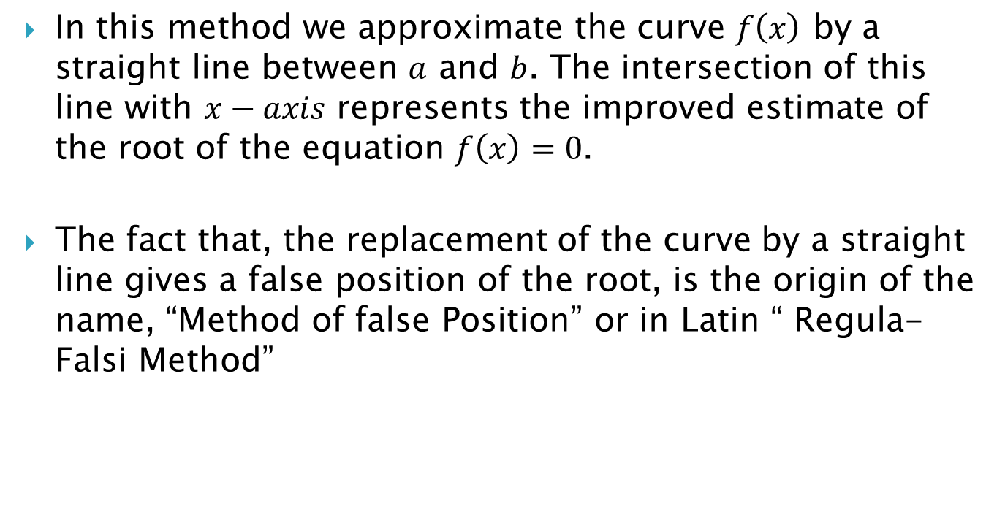
The False Position Method
In this method we approximate the curve $f\left(x\right)$ by a straight line between $a$ and $b$. The intersection of this line with $x−axis$ represents the improved estimate of the root of the equation $f\left(x\right)=0$.
The fact that, the replacement of the curve by a straight line gives a false position of the root, is the origin of the name, “Method of false Position” or in Latin “ Regula-Falsi Method”

Slide 3
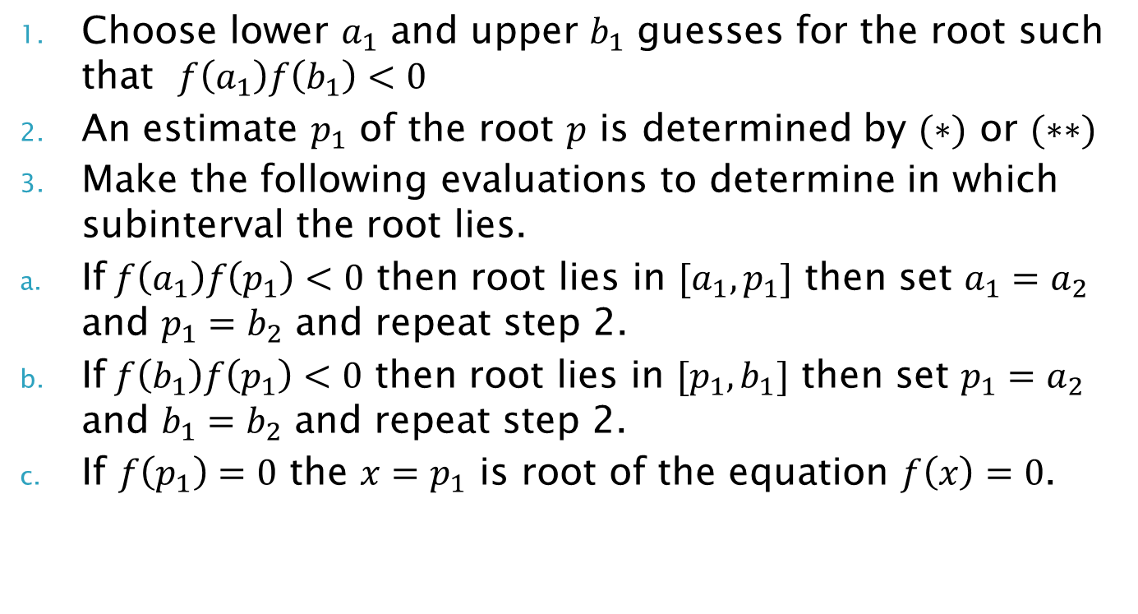
Algorithm
Choose lower $a_{1}$ and upper $b_{1}$ guesses for the root such that $f\left(a_{1}\right)f\left(b_{1}\right)<0$
An estimate $p_{1}$ of the root $p$ is determined by $(∗)$ or $(∗∗)$
Make the following evaluations to determine in which subinterval the root lies.
If$f\left(a_{1}\right)f\left(p_{1}\right)<0$ then root lies in $[a_{1},p_{1}]$ then set $a_{1}=a_{2}$ and $p_{1}=b_{2}$ and repeat step 2.
If$f\left(b_{1}\right)f\left(p_{1}\right)<0$ then root lies in $[p_{1},b_{1}]$ then set $p_{1}=a_{2}$ and $b_{1}=b_{2}$ and repeat step 2.
If $f\left(p_{1}\right)=0$ the $x=p_{1}$ is root of the equation $f\left(x\right)=0$.

Slide 4
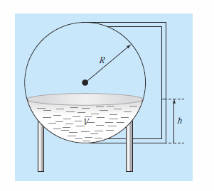
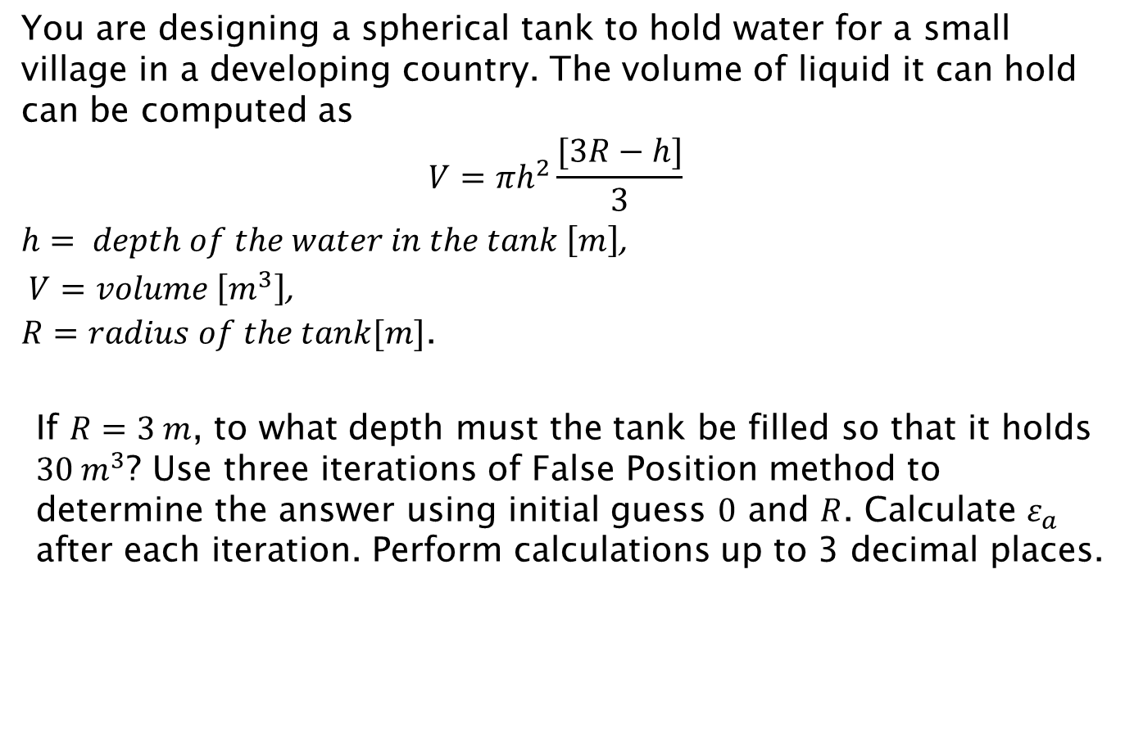
Example
You are designing a spherical tank to hold water for a small village in a developing country. The volume of liquid it can hold can be computed as
$$V=πh^{2}\frac{[3R−h]}{3}$$
$h= depth of the water in the tank \left[m\right]$,
$V=volume \left[m^{3}\right]$,
$R=radius of the tank[m]$.
If $R=3 m$, to what depth must the tank be filled so that it holds $30 m^{3}$? Use three iterations of False Position method to determine the answer using initial guess $0$ and $R$. Calculate $ε_{a}$ after each iteration. Perform calculations up to 3 decimal places.

Slide 5
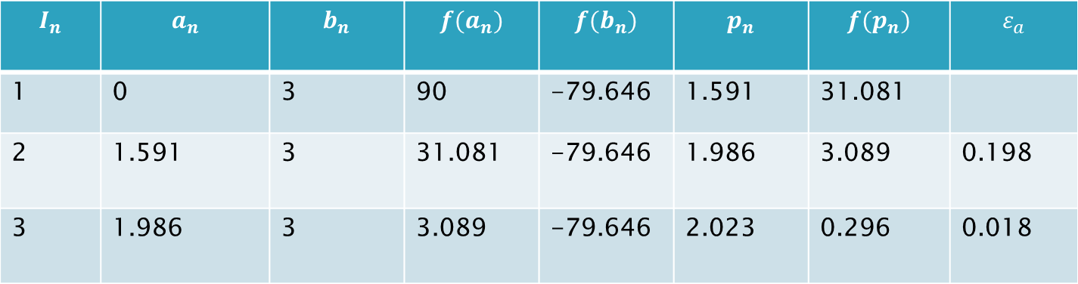
Example:
$$I_{n}$$ | $$a_{n}$$ | $$b_{n}$$ | $$f(a_{n})$$ | $$f(b_{n})$$ | $$p_{n}$$ | $$f(p_{n})$$ | $$ε_{a}$$
1 | 0 | 3 | 90 | -79.646 | 1.591 | 31.081
2 | 1.591 | 3 | 31.081 | -79.646 | 1.986 | 3.089 | 0.198
3 | 1.986 | 3 | 3.089 | -79.646 | 2.023 | 0.296 | 0.018
The root of the equation is $x=2.023$.
Home Exercise:
Approximate $h$ such that $ε_{a}<0.5\%$

Slide 6
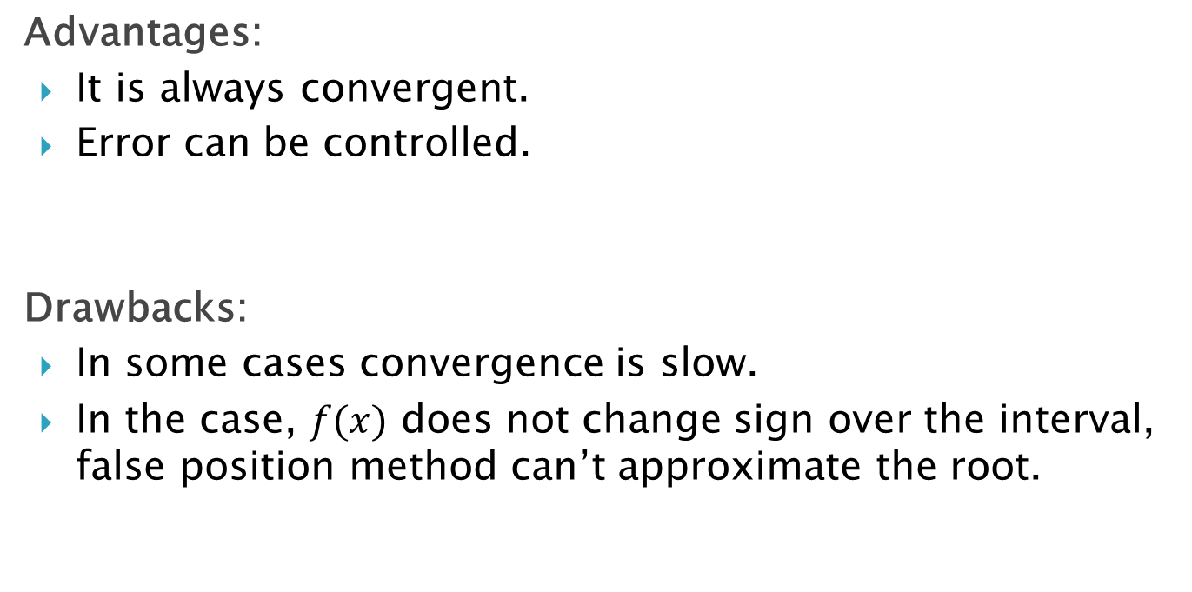
Advantages:
It is always convergent.
Error can be controlled.
Drawbacks:
In some cases convergence is slow.
In the case, $f(x)$ does not change sign over the interval, false position method can’t approximate the root.

Slide 7
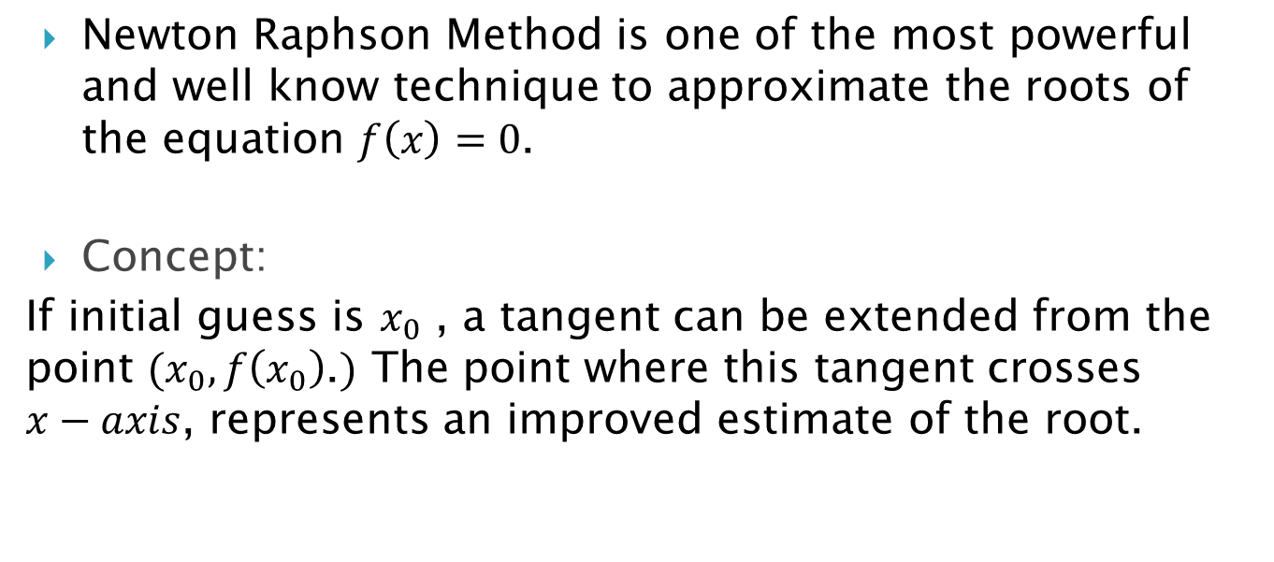
Newton Raphson Method
Newton Raphson Method is one of the most powerful and well know technique to approximate the roots of the equation $f\left(x\right)=0$.
Concept:
If initial guess is $x_{0}$ , a tangent can be extended from the point $(x_{0}, f\left(x_{0}\right)$.$)$ The point where this tangent crosses $x−axis$, represents an improved estimate of the root.

Slide 8
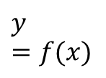




Graphically Interpretation
$$y=f(x)$$
$$\left(x_{0} , f\left(x_{0}\right)\right)$$
$$x_{2}$$
$$x_{1}$$
$$x_{0}$$
$$root$$

Slide 9
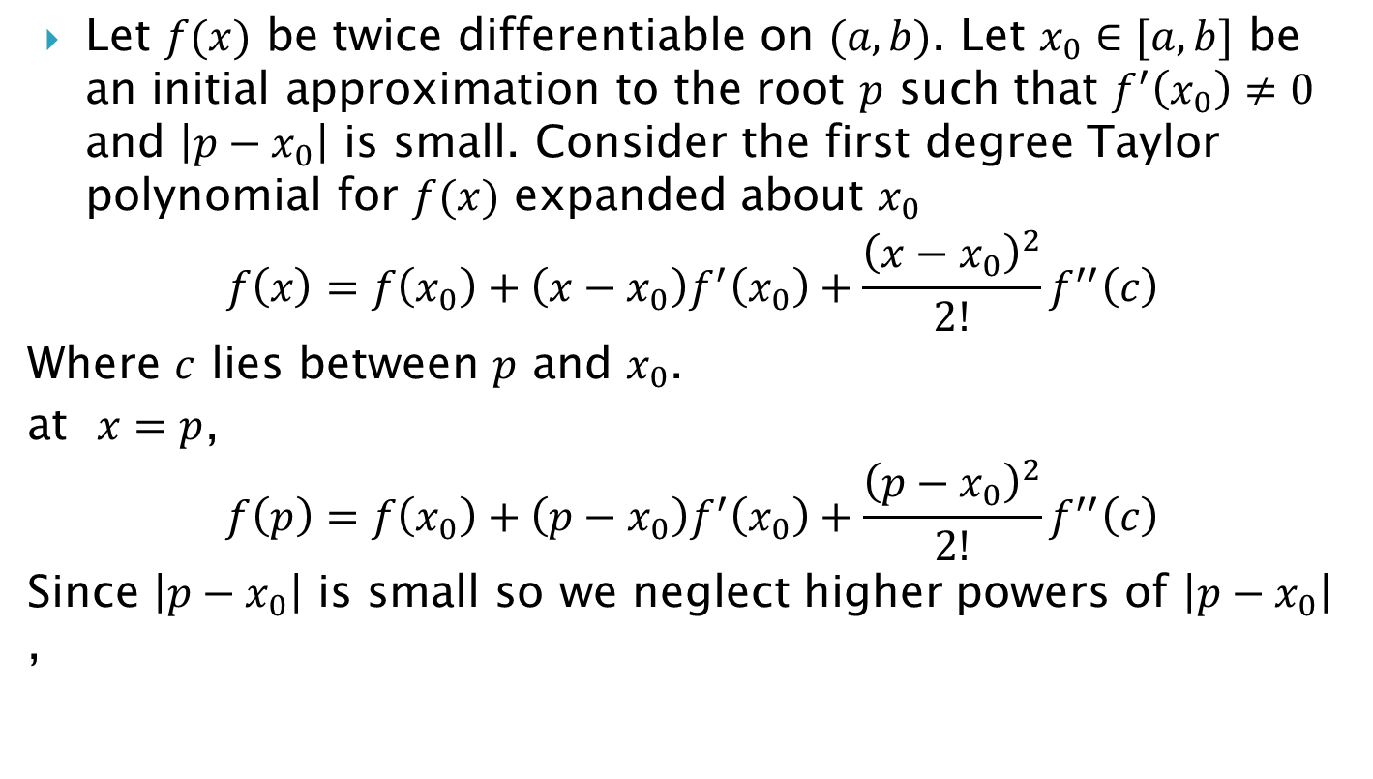
Derivation of Formula
Let $f(x)$ be twice differentiable on $(a,b)$. Let $x_{0}∈[a,b]$ be an initial approximation to the root $p$ such that $f^{′}\left(x_{0}\right)≠0$ and $\left|p−x_{0}\right|$ is small. Consider the first degree Taylor polynomial for $f(x)$ expanded about $x_{0}$
$$f\left(x\right)=f\left(x_{0}\right)+\left(x−x_{0}\right)f^{′}\left(x_{0}\right)+\frac{{\left(x−x_{0}\right)}^{2}}{2!}f^{′′}\left(c\right)$$
Where $c$ lies between $p$ and $x_{0}$.
at $x=p$,
$$f\left(p\right)=f\left(x_{0}\right)+\left(p−x_{0}\right)f^{′}\left(x_{0}\right)+\frac{{\left(p−x_{0}\right)}^{2}}{2!}f^{′′}\left(c\right)$$
Since $\left|p−x_{0}\right|$ is small so we neglect higher powers of $\left|p−x_{0}\right|$ ,

Slide 10
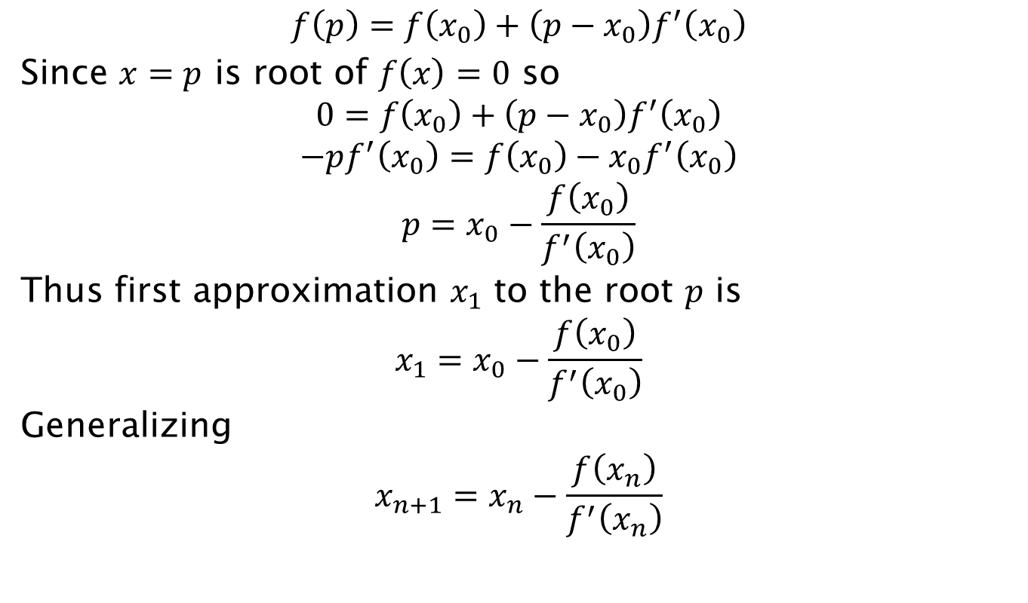
$$f\left(p\right)=f\left(x_{0}\right)+\left(p−x_{0}\right)f^{′}\left(x_{0}\right)$$
Since $x=p$ is root of $f\left(x\right)=0$ so
$$0=f\left(x_{0}\right)+\left(p−x_{0}\right)f^{′}\left(x_{0}\right)$$
$$−pf^{′}\left(x_{0}\right)=f\left(x_{0}\right)−x_{0}f^{′}\left(x_{0}\right)$$
$$p=x_{0}−\frac{f\left(x_{0}\right)}{f^{′}\left(x_{0}\right)}$$
Thus first approximation $x_{1}$ to the root $p$ is
$$x_{1}=x_{0}−\frac{f\left(x_{0}\right)}{f^{′}\left(x_{0}\right)}$$
Generalizing
$$x_{n+1}=x_{n}−\frac{f\left(x_{n}\right)}{f^{′}\left(x_{n}\right)}$$

Slide 11
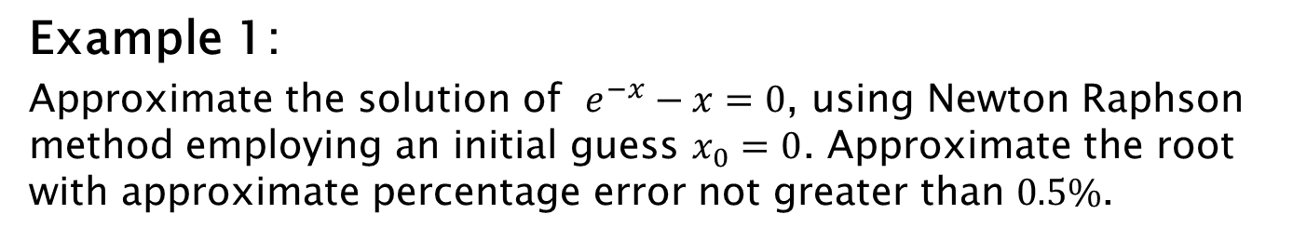
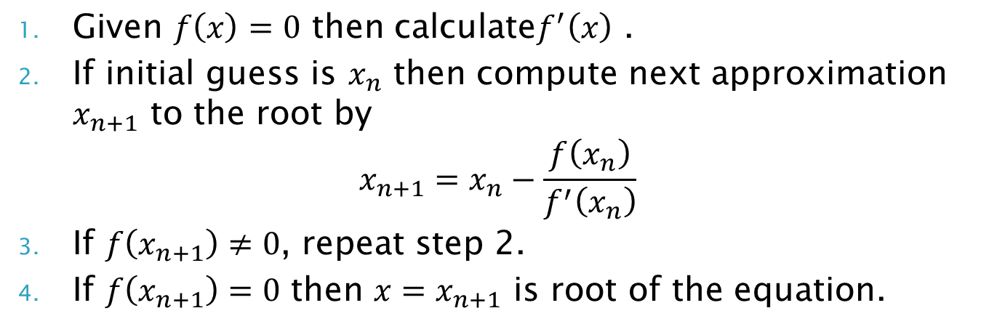
Algorithm
Given $f\left(x\right)=0$ then calculate$f^{′}\left(x\right)$ .
If initial guess is $x_{n}$ then compute next approximation $x_{n+1}$ to the root by
$$x_{n+1}=x_{n}−\frac{f\left(x_{n}\right)}{f^{′}\left(x_{n}\right)}$$
If $f\left(x_{n+1}\right)≠0$, repeat step 2.
If $f\left(x_{n+1}\right)=0$ then $x=x_{n+1}$ is root of the equation.
Example 1:
Approximate the solution of $e^{−x}−x=0$, using Newton Raphson method employing an initial guess $x_{0}=0$. Approximate the root with approximate percentage error not greater than $0.5\%$.

